Slide 1

Machine Learning Algorithms
Data Analytics Department Bridgerland Technical College

Slide 2

Content
Difference of discrete and continuous
Diagram of Machine Learning Algorithms
Supervised learning
Unsupervised learning
Reinforcement learning

Slide 3
Various Data Types
There is structured and unstructured data
There is quantitative and qualitative data
There is discrete and continuous data for quantitative data

Slide 4
Discrete vs. Continuous
Discrete data (Categorical data)
Can only take a limited number of values
Has spaces between values
Values: Integer numbers
Examples:
Number of students in a class
Number of children per family
Graphs:
Bar graphs
Pie charts
Stem-and-leaf-plot
Continuous data
Takes unspecified number of possible measurements between two data points
Creates a defined range. No spaces between values
Values: Decimal and whole numbers
Examples:
Weight
Height
Temperature
Graphs:
Line graphs
Histograms
Skews

Slide 5
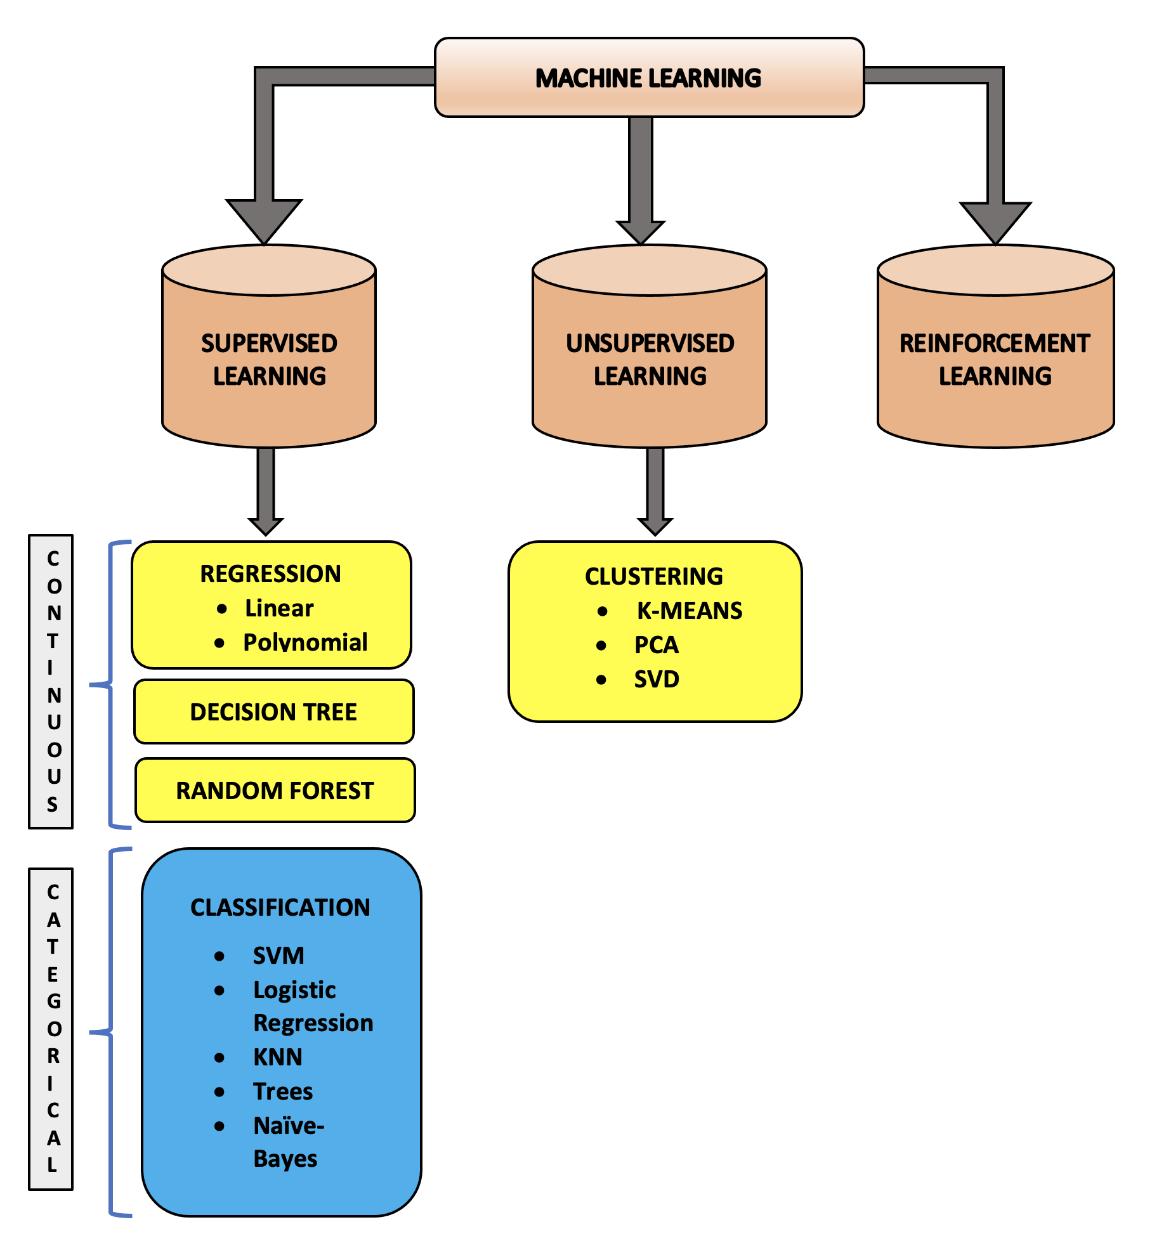
Machine Learning Algorithms
There are three approaches to solve a ML task:
Supervised Learning
Unsupervised Learning
Reinforcement Learning

Slide 6
Supervised Learning
Train the machine using labeled data (training data)
The input data is a labeled input that is fed into the model and go through the ML process and gets labelled output as an outcome (as shown in the next slide)
Supervised learning has two categories: Classification and Regression.

Slide 7
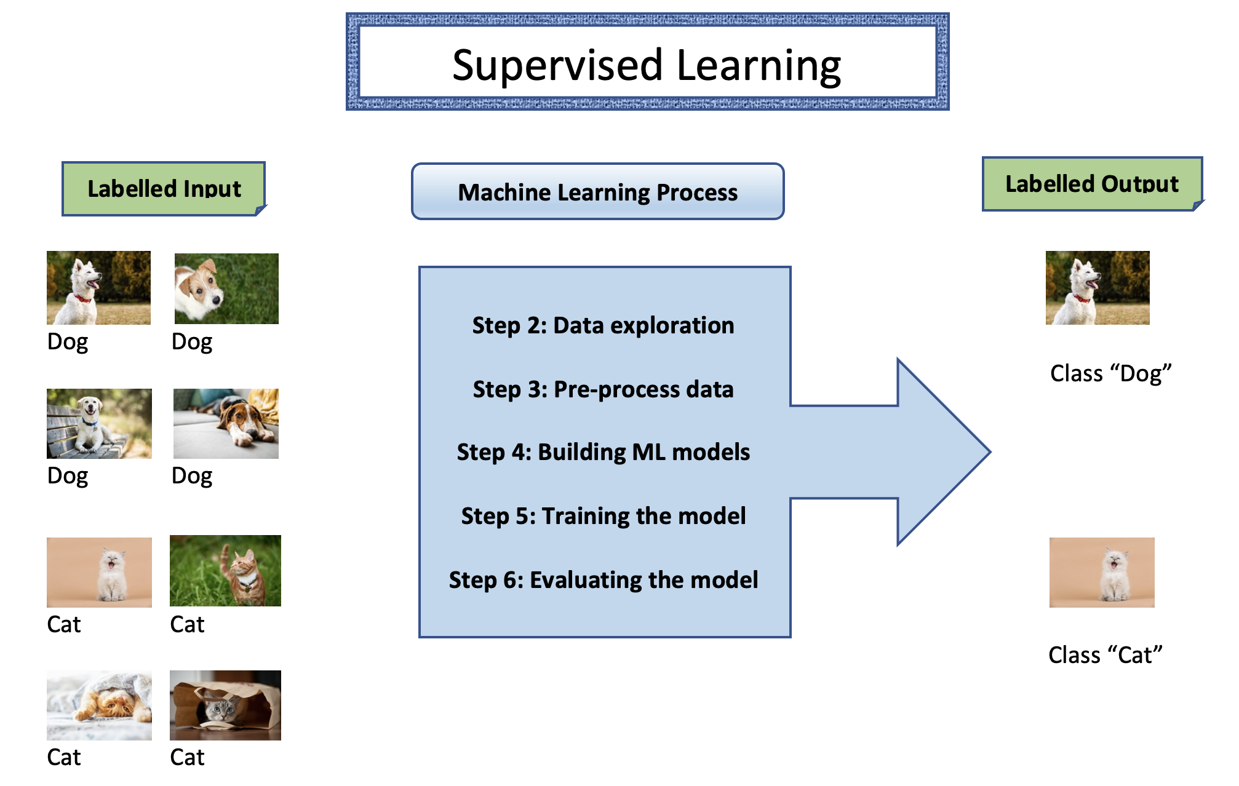

Slide 8
Supervised Learning
Classification:
When the target variable is categorical, and the output is classified into classes.
Examples:
Classifying spam into a different folder than inbox folder
Classifying “disease” and “no disease”; “rain” and “no rain”; “cat” and “no cat”, etc.
Common classification algorithms:
Naïve Bayes
Decision Trees
Random Forest
SVM (Support Vector Machine)
Logistic Regression
KNN (K-Nearest Neighbor)

Slide 9
Supervised Learning
Regression:
When the target variable is continuous, and the output is numeric.
Examples:
Predicting the price of a house
Predicting stock exchange prices, etc.
Common regression algorithms:
Linear Regression
Support Vector Regression
Decision Tree
Random Forest
Gaussian Progresses Regression

Slide 10
Unsupervised Learning
Train the machine using unlabeled data (training data)
The input data is an unlabeled input that is fed into the model and go through the ML process and gets clusters formed based on similarity (unlabeled output) as the outcome (as shown in the next slide)
Unsupervised learning has two categories: Clustering and Association

Slide 11
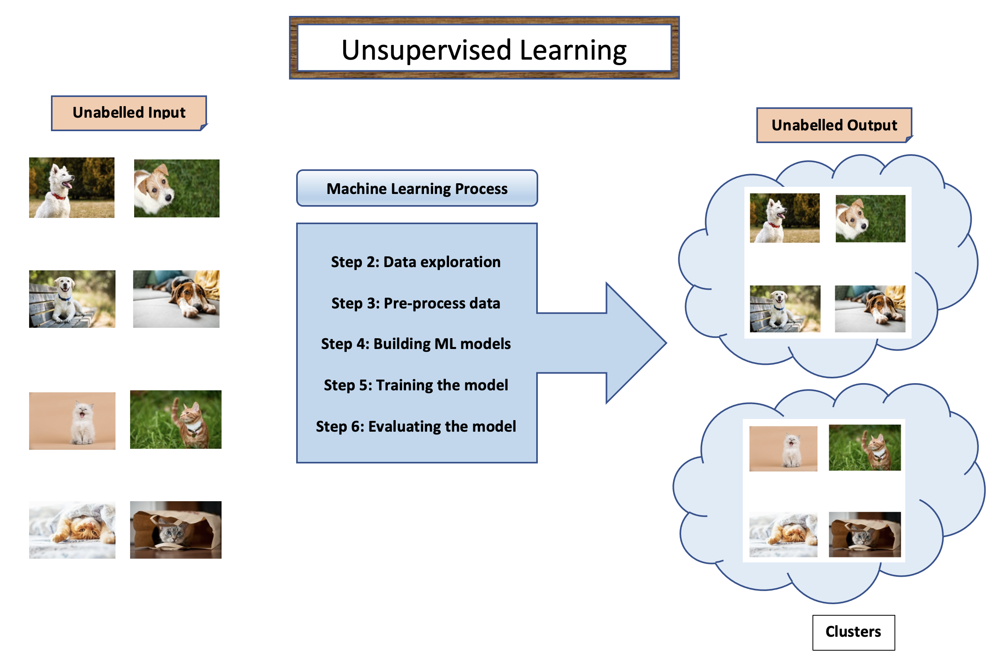

Slide 12
Unsupervised Learning
Clustering:
Here we find hidden patterns in the data based on the feature similarities or differences(e.g., size, shape, color, etc)
Examples: customer segmentation, targeted marketing, recommender systems.
Common clustering algorithms:
K-mean clustering
Hierarchical clustering
In this course, we will focus on the supervised learning algorithms. I invite to do your own research about unsupervised learning algorithms.

Slide 13
Prepare: Comparison Table
Supervised Learning | Unsupervised Learning
Create a comparison table of supervised and unsupervised learning.
You can add any new information that you might find on the internet
You will be asked to create this table as part of your assignment for this section

Slide 14
Reinforcement Learning
“Reinforcement Learning is a part of Machine learning where an agent is put in an environment, and he learns to behave in this environment by performing certain actions and observing the rewards which it gets from those actions.”
Example: self-driving cars, AlphaGo, etc.
(Reference: Edureka: https://www.edureka.co/blog/introduction-to-machine-learning/ )

Slide 15

References
Images ideas from Edureka (https://www.edureka.co/blog/introduction-to-machine-learning/ )

Slide 16

Questions?

